Slide 1
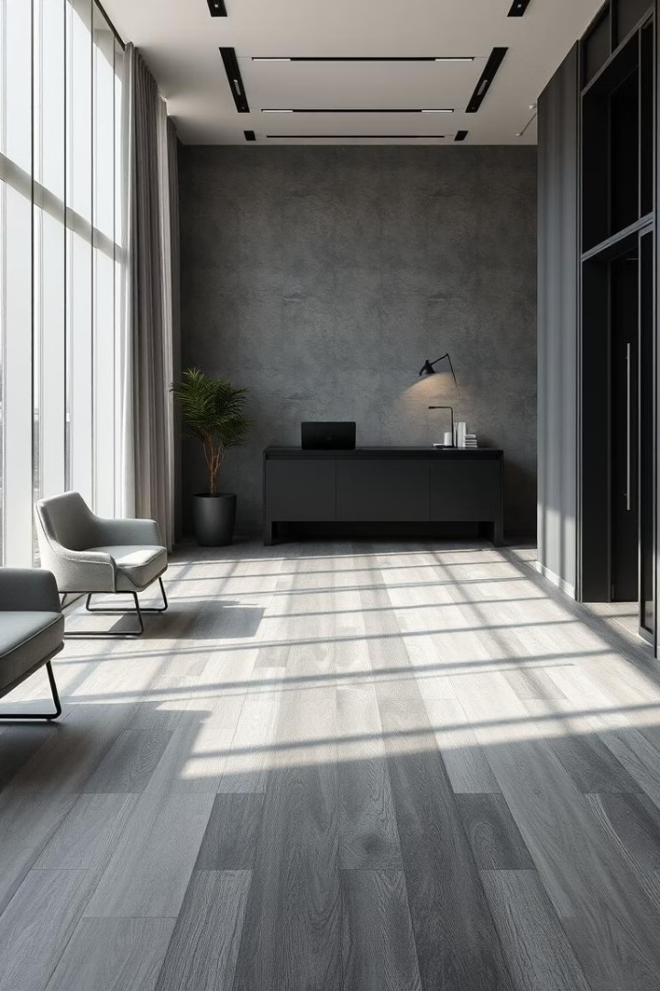
Floor Covering: A Comprehensive Guide
This guide explores various floor coverings, materials, and trends to help you create stunning, durable spaces. Learn how to select the best flooring suited to your style, budget, and lifestyle.

Slide 2
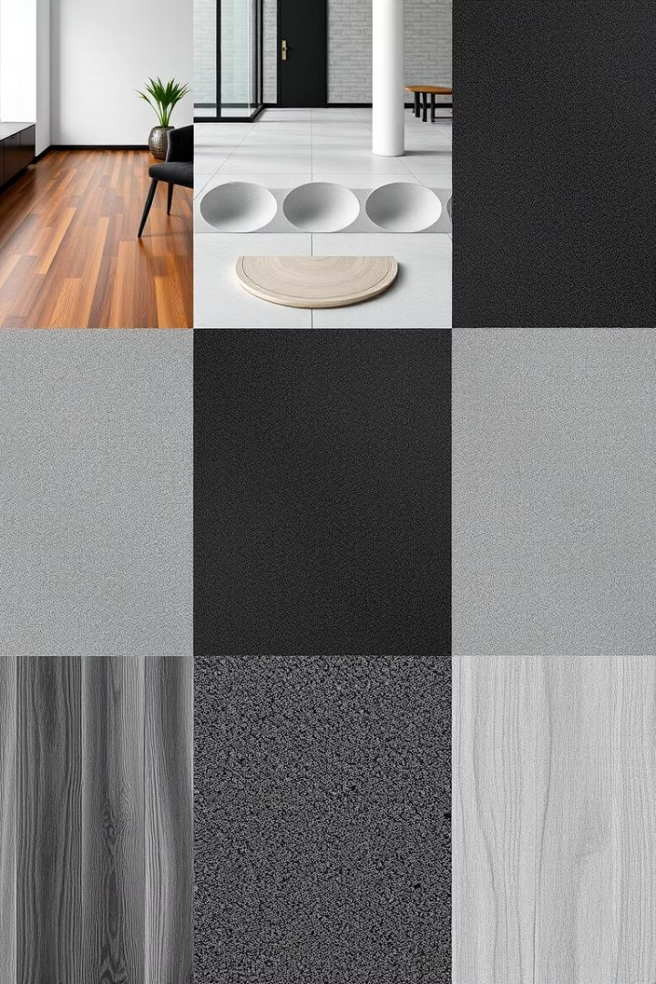
Types of Floor Covering: Pros and Cons
Hardwood
Elegant and durable but can be costly and prone to scratches.
Carpet
Soft and warm but harder to maintain and less durable.
Vinyl
Waterproof and affordable, though can look less natural.
Tile
Durable and easy to clean but cold and can be slippery.

Slide 3
Choosing the Right Material: Considerations
Durability
Comfort
Maintenance
Budget
High-traffic areas require tough, scratch-resistant floors.
Softer floors suit bedrooms; hard floors better for kitchens.
Consider ease of cleaning and long-term upkeep.
Materials vary widely in cost; balance price and quality.

Slide 4
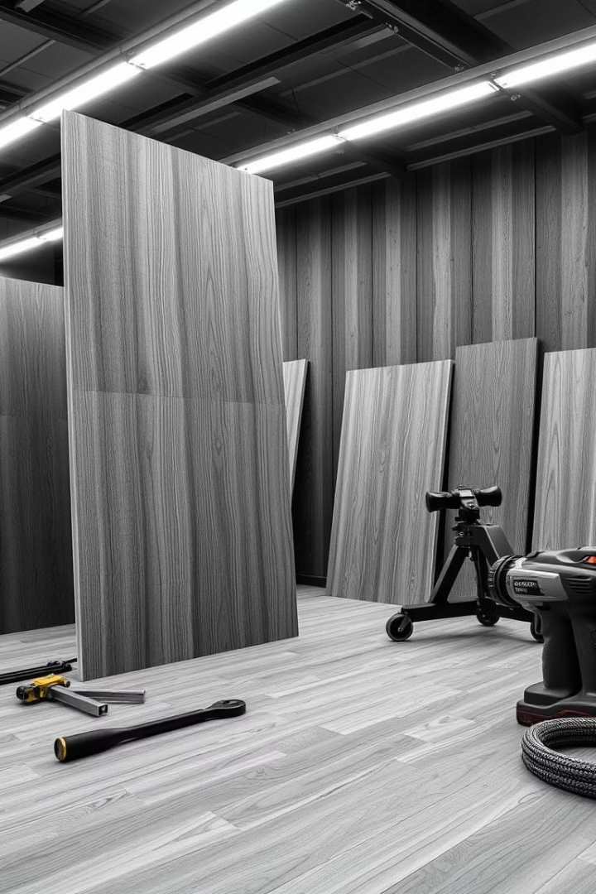




Installation: A Step-by-Step Guide
Preparation
Clean and level the subfloor before starting.
Layout Planning
Mark guides to ensure straight, uniform placement.
Laying Material
Place flooring pieces carefully according to type.
Finishing
Seal, polish, or trim edges for a professional look.

Slide 5
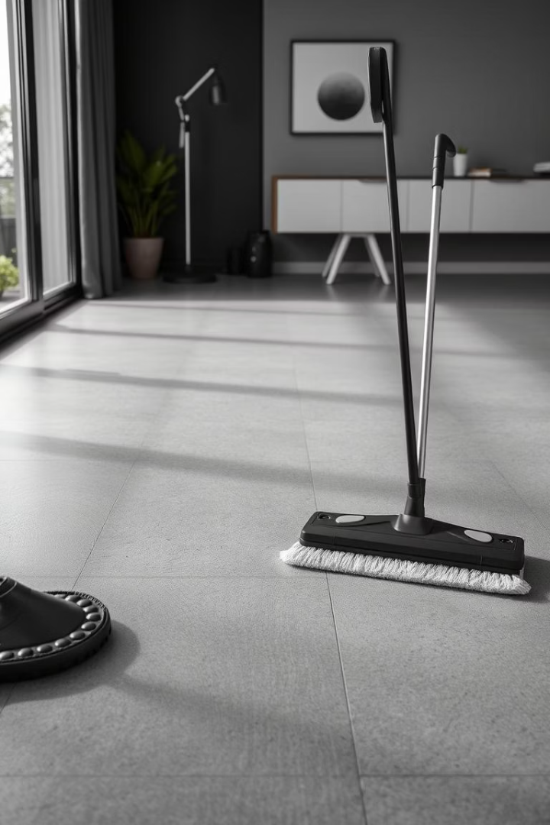
Maintenance and Care Tips
Regular Cleaning
Sweep or vacuum to remove dirt and debris.
Protective Measures
Use furniture pads to prevent scratches.
Spill Management
Clean spills immediately to avoid staining.
Periodic Maintenance
Refinish or reseal floors as recommended.

Slide 6

Cost Analysis: Budgeting for Your Floor
Material
Average Cost per m²
Hardwood
£40 - £80
Carpet
£10 - £30
Vinyl
£15 - £40
Tile
£25 - £50
Labour, underlay, and finishing costs add to the material price. Allow contingency for unforeseen expenses.

Slide 7
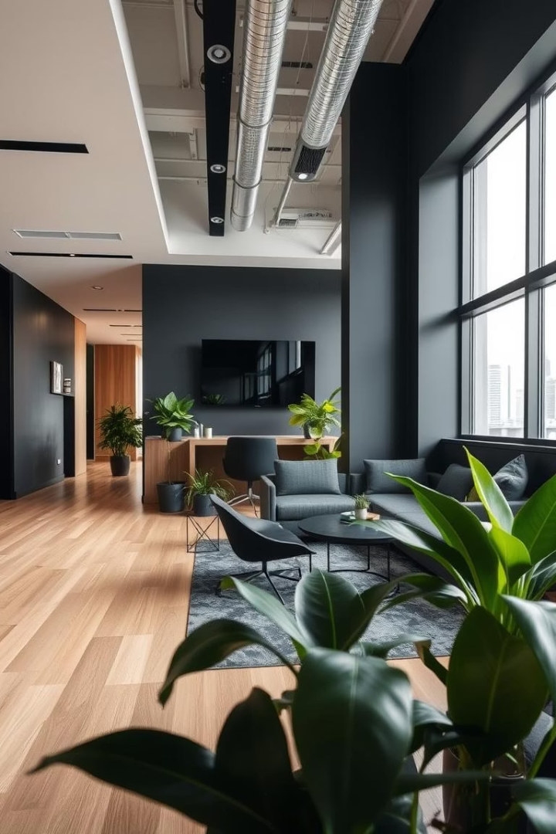



Trends in Floor Covering: What's New?
Eco-friendly Materials
Rise in sustainably sourced and recycled flooring options.
Bold Patterns
Geometric and artistic floor designs gain popularity.
Water-resistant Innovations
Vinyl and laminate floors now offer superior moisture resistance.

Slide 8

Q&A and Conclusion: Expert Advice
Stay Informed
Plan Budget
Keep up with trends and new technologies in flooring.
Consult Professionals
Include materials, labour, and maintenance costs.
Assess Needs
Seek guidance for installation and long-term care.
Understand your space and lifestyle before choosing materials.
Thank you for exploring floor covering options. Ready to transform your space?

